Slide 1




Dissertation Defense | Argued by PhD Filipe Soares
17th July 2025 | FEUP
CHARACTERIZATION OF RETINAL
FLUID IN OPTICAL COHERENCE
TOMOGRAPHY IMAGES
Master in Biomedical Engineering
Authored by David Castanho Terroso
Supervised by Prof. Tânia Melo & Co-supervised by Prof. Ana Maria Mendonça
Notes:
Bom dia a todos, o meu nome é David Castanho Terroso e irei apresentar o trabalho realizado até ao momento, na unidade curricular de Projeto de Dissertação.
O tema escolhido para a minha dissertação foi “Characterization of Retinal Fluid in Optical Coherence Tomography images”, sob orientação da professora Ana Mendonça e coorientação de Tânia Melo.

Slide 2
01
02
03
04
05
06
07
08
Problem
Dissertation Objectives
Literature Review
Materials and Methods
Experiments
Results and Discussion
Conclusion
Limitations and Future Work
SUMMARY
Notes:
Nesta apresentação, irei abordar o problema que pretendo resolver com a minha dissertação, esclarecendo em seguida os objetivos. Em seguida, apresentarei o progresso feito no estado de arte em dois temas relevantes a desenvolver na dissertação e, por fim, alguns dos métodos estipulados para utilizar ao longo deste processo.

Slide 3

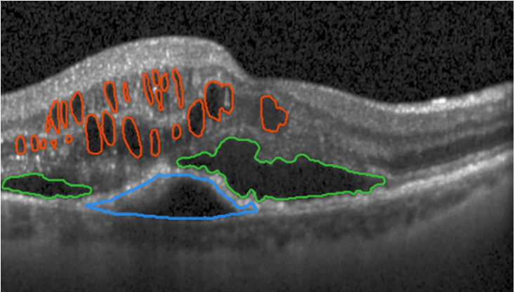


01
PROBLEM
Some Leading Causes of Blindness
Age-related Macular Degeneration (AMD)
Diabetic Macular Edema (DME)
Macular Edema Secondary to Retinal Vein Occlusion (RVO)
Characterized by leaking fluid onto the retina
Which can be classified in:
Intraretinal Fluid (IRF)
Subretinal Fluid (SRF)
Pigmental Epithelium Detatchment (PED)
IRF in red, SRF in green, and PED in blue [1]
Characterization of fluid:
Important biomarker;
Laborious task;
Conditioned by medical expertise and OCT quality and resolution.
[1] H. Bogunović et al., Chapter 14 - OCT fluid detection and quantification, pp. 273–298. Academic Press, 2019.
03|33

Slide 4

Analyze retinal OCT scans, classifying the retinal fluids in three different types (IRF, SRF, and PED) and quantifying their respective volumes.
Increase the inter-slice resolution of the OCT volumes, with the aim of improving the fluid volume estimation.
02
DISSERTATION OBJECTIVES
1
Develop different 2D deep learning models for the segmentation of different retinal fluid types (IRF, SRF, and PED) in OCT volumes.
2
Evaluate the performance of the best segmentation model in different datasets and estimate the volume of each fluid using its predicted masks.
Use a generative model for synthesizing intermediate slices in OCT volumes, in order to improve their inter-slice resolution of the volume, and assessing the quality of the super-resolved volume.
3
4
Investigate the impact of intermediate slice synthesis on the fluid volume estimation.
04|33

Slide 5




03
LITERATURE REVIEW
03.A
FLUID SEGMENTATION
Excluded: 688
Search Query (on Title or Abstract):
Duplicates: 133
Abstract Screening: 499
Full-text Screening: 56
"OCT" AND "segmentation" AND
("deep learning" OR "CNN" OR "neural network")
Criteria:
Before 2019;
Without full-text available in English;
Books, thesis, conference, or review articles.
PubMed: 398
IEEE: 105
ScienceDirect: 125
ACM: 80
Databases
Included: 20
Criteria:
Articles focused on 2D or 2.5D segmentation in OCT volumes.
05|33

Slide 6
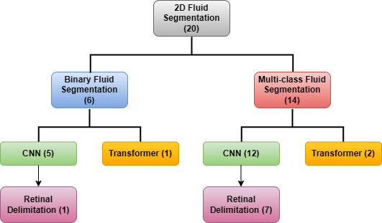
03
LITERATURE REVIEW
03.A
FLUID SEGMENTATION
Convolutional Neural Networks (CNNs)
Inspired by the U-Net;
Main approach to the segmentation problem;
Implementations differ on the modules, blocks, or type of convolutions used.
Transformers
Combined with CNNs, replacing the encoding path or the bottleneck part of the network;
All Transformers work alongside with CNNs.
Retinal Delimitation
Common practice to discard irrelevant information;
Easier training and more anatomically coherent results.
06|33

Slide 7
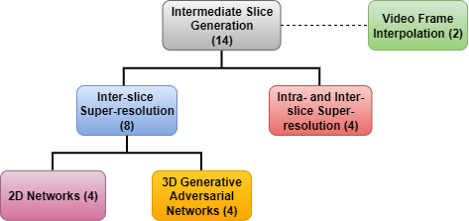
03
LITERATURE REVIEW
03.B
INTERMEDIATE SLICE SYNTHESIS
Inter-slice Super-resolution with 2D Networks
Considers two consecutive slices and learns to generate one intermediate slice;
Intra- and Inter-slice Super-resolution
Usually composed by three networks: two intra-slice, one inter-slice;
Intra-slice super-resolution is performed on the orthogonal 2D views;
Inter-slice super-resolution is applied simultaneously and mutual supervision between the three axes occurs.
3D Generative Adversarial Networks
Considers the whole low-resolution volume and outputs a high-resolution one;
Computationally expensive.
Video Frame Interpolation
Can be used as inspiration for intermediate slice generation in medical images.
07|33

Slide 8
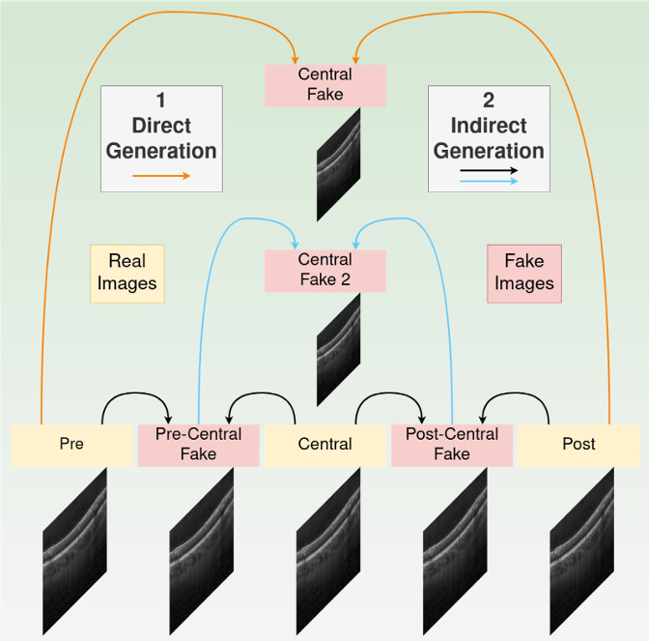
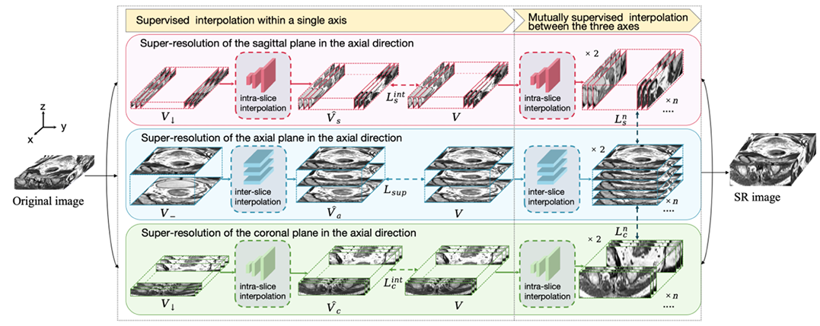
03
LITERATURE REVIEW
03.B
INTERMEDIATE SLICE SYNTHESIS
[3] H. Zhang et al., “A novel GAN-based three-axis mutually supervised super-resolution reconstruction method for rectal cancer MR image” Computer Methods and Programs in Biomedicine, vol. 257, p. 108426, 2024.
[2] E. López-Varela et al., “Generation of synthetic intermediate slices in 3D OCT cubes for improving pathology detection and monitoring” Computers in Biology and Medicine, vol. 163, p. 107214, 2023.
08|33

Slide 9
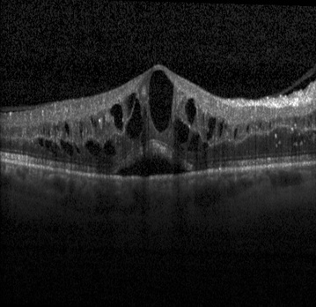
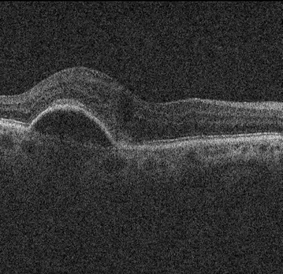
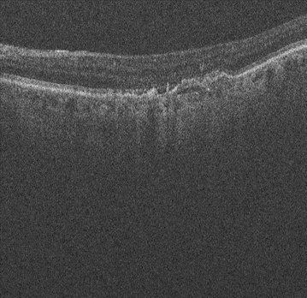
04
MATERIALS AND METHODS
04.A
DATASETS
RETOUCH [4]:
One of the most popular datasets for retinal fluid segmentation in OCT exams;
Large dataset with 112 volumes and 11334 B-scans;
Volumes from three different devices (Spectralis, Cirrus, and Topcon);
Constant volume size for the same vendor.
Provides QUANTITY and VARIETY
Spectralis
Cirrus
Topcon
[4] H. Bogunović et al., “RETOUCH: The Retinal OCT Fluid Detection and Segmentation Benchmark and Challenge” IEEE Transactions on Medical Imaging, vol. 38, pp. 1858–1874, 2019.
09|33

Slide 10
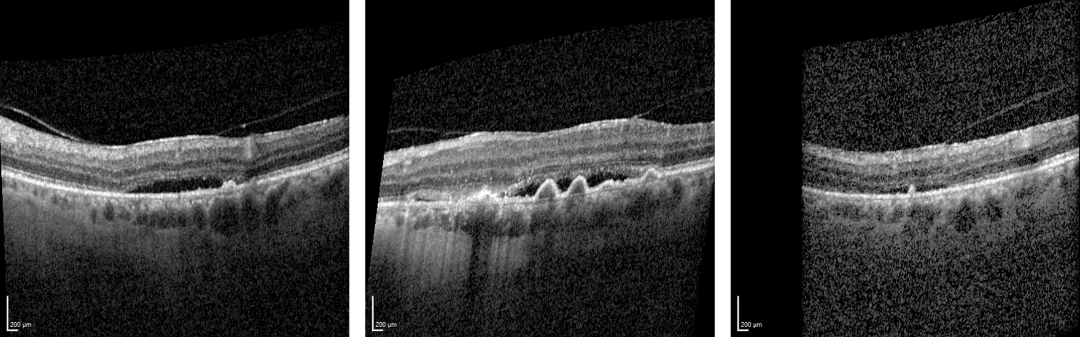
MATERIALS AND METHODS
04
MATERIALS AND METHODS
04
04.A
DATASETS
Centro Hospitalar Universitário de São João (CHUSJ):
Private OCT dataset, with anotated fluids;
Small dataset, with 6 volumes and 114 B-scans;
Volumes from Spectralis;
Varying image sizes, noise levels, and visual characteristics across volumes.
Allows validation on EXTERNAL data
10|33

Slide 11
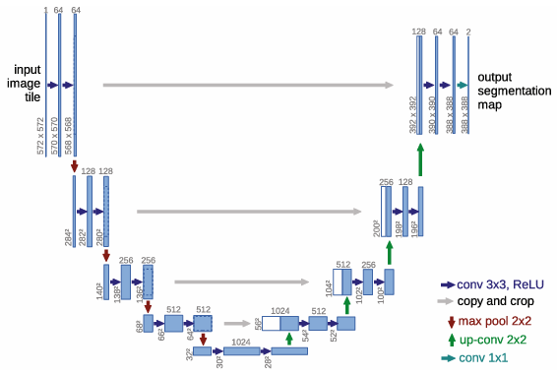
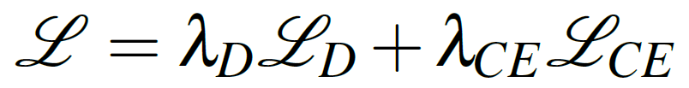
MATERIALS AND METHODS
04
MATERIALS AND METHODS
04
04.B
FLUID SEGMENTATION - NETWORK AND LOSS FUNCTION
Selected Network: U-Net [5]
Loss Function [6]
0.5
0.5
Dice Loss
Balanced Cross-Entropy Loss
[5] O. Ronneberger, et al., “U-Net: Convolutional Net works for Biomedical Image Segmentation” in Medical Image Computing and Computer-Assisted Intervention– MICCAI 2015 (N. Navab, J. Hornegger, W. M. Wells, and A. F. Frangi, eds.), pp. 234–241, Springer International Publishing, 2015.
[6] R. Tennakoon et al., “Retinal fluid segmentation in OCT images using adversarial loss based convolutional neural networks” in 2018 IEEE 15th International Symposium on Biomedical Imaging (ISBI 2018), 2018, pp. 1436–1440. DOI: 10.1109/ISBI.2018.8363842.
11|33

Slide 12
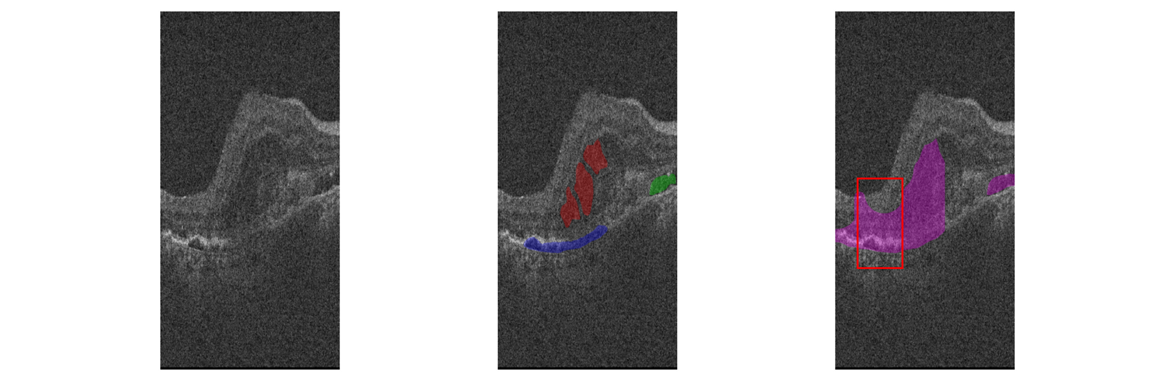
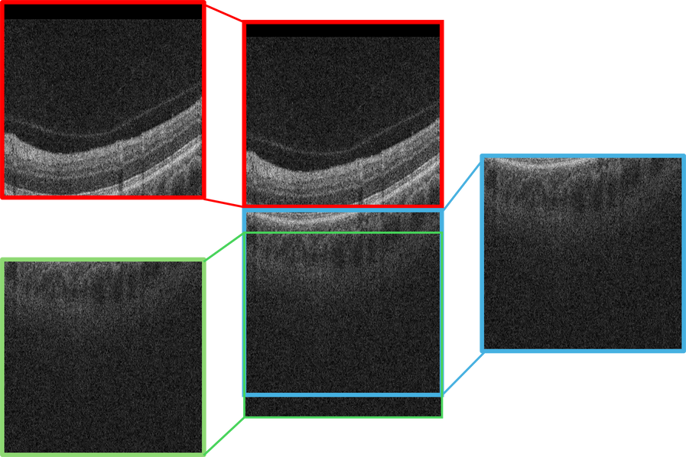
MATERIALS AND METHODS
MATERIALS AND METHODS
04
MATERIALS AND METHODS
04
04
04.B
FLUID SEGMENTATION - PATCH EXTRACTION
A. Small Patch Extraction
B. Large Patch Extraction
496 × 512
496 × 512
IRF in red, SRF in green, PED in blue, and the region of interest in purple (right).
The red bounding box represents a possible patch.
496 × 512
256 x 128 (H x W) patches extracted from the region of interest (ROI);
The ROI consists of the regions with highest entropy or with fluid;
10 patches are randomly extracted from this region in each B-scan.
496 x 512 patches extracted from each B-scan;
The patches were extracted from top to bottom so that every section of the image was present in at least one patch.
12|33

Slide 13

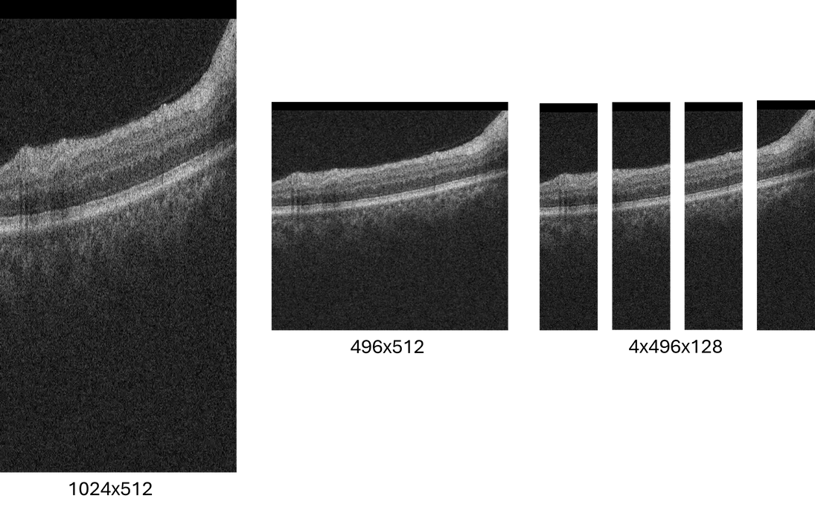
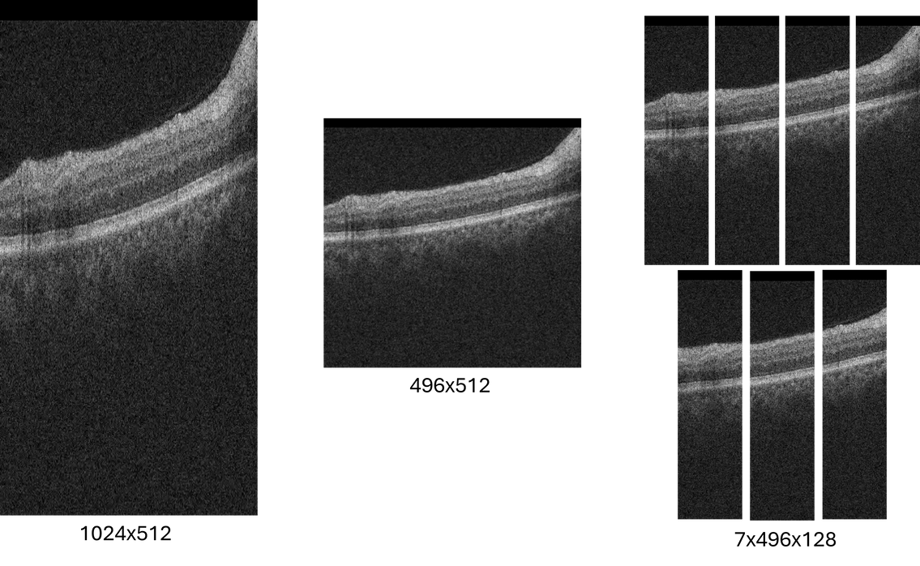
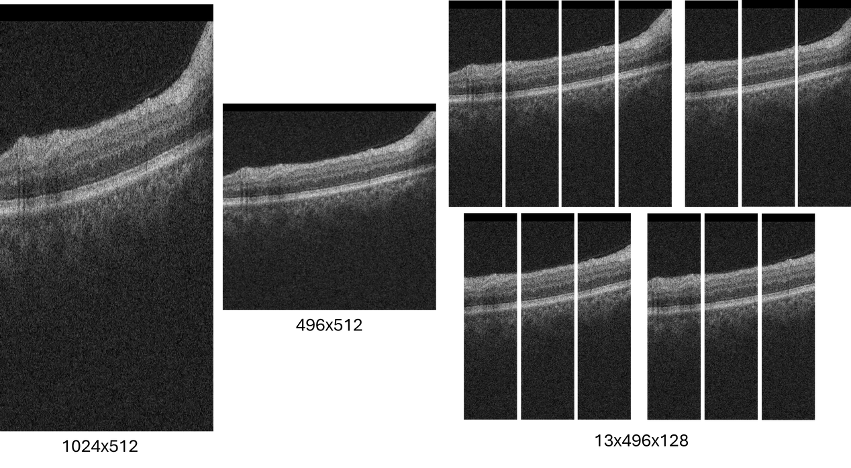
MATERIALS AND METHODS
MATERIALS AND METHODS
04
MATERIALS AND METHODS
04
04
04.B
FLUID SEGMENTATION - PATCH EXTRACTION
C. Vertical Patch Extraction
All B-scans were reshaped to 496 x 512;
Four, seven, or thirteen patches of shape 496 x 128 were extracted from each B-scan;
The four extracted patches were disjoint, while the seven and thirteen patches were sampled at regular intervals along the horizontal axis, starting from the left of the image and ending at the last position where a full-width patch could be extracted.
13|33

Slide 14
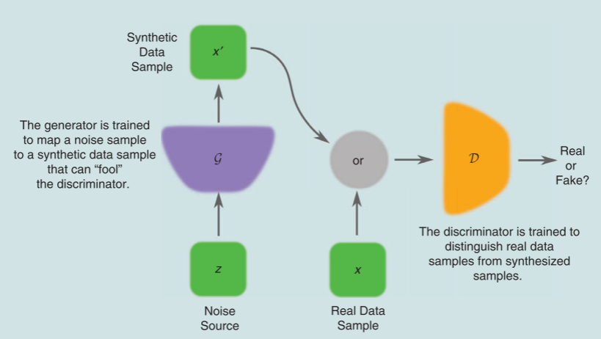
MATERIALS AND METHODS
MATERIALS AND METHODS
04
MATERIALS AND METHODS
04
04
04.B
INTERMEDIATE SLICE GENERATION - NETWORKS
Generative Adversarial Network:
Inspired by the work of Tran and Yang [7];
The generator receives two consecutive slices and then generates the intermediate slice, while the discriminator must correctly distinguish the real slices from the generated ones;
As the generator gets better, so does the discriminator.
U-Net:
A generative U-Net was also tested for the generatation of an intermediate B-scan, motitvated by the work of Nishimoto et al. [9];
The training is performed using the entire B-scans and regulated using the MAE.
[7] Q. N. Tran and S.-H. Yang, “Efficient Video Frame Interpolation Using Generative Adversarial Networks” Applied Sciences, vol. 10, 18 2020, ISSN: 2076-3417. DOI: 10.3390/app10186245.
[8] A. Creswell et al., “Generative Adversarial Networks: An Overview” IEEE Signal Processing Magazine, vol. 35, pp. 53–65, 2018.
[9] S. Nishimoto et al., “Generating intermediate slices with U-nets in craniofacial CT images” medRxiv, p. 2024.05.08.24307089, Jan. 2024. DOI: 10.1101/2024.05.08.24307089.
D is the discriminator and G is the generator [8].
14|33

Slide 15
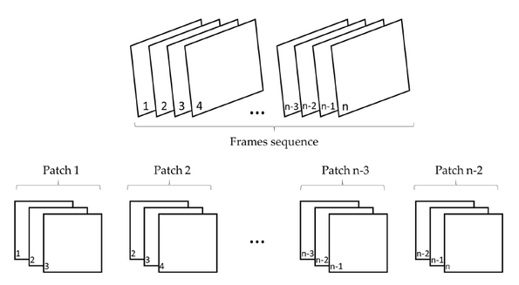
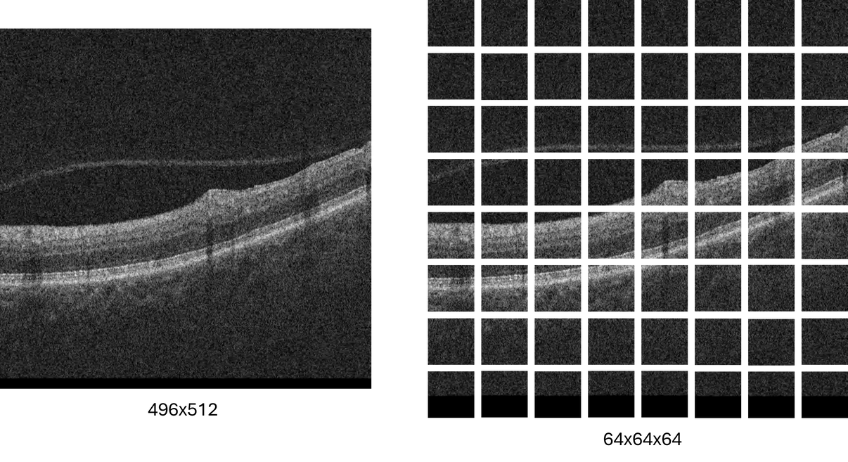
MATERIALS AND METHODS
MATERIALS AND METHODS
04
MATERIALS AND METHODS
04
04
04.B
INTERMEDIATE SLICE GENERATION - PATCH EXTRACTION AND LOSS
Training Patches:
The network was trained using triplets of 64 x 64 patches, extracted from B-scans previously resized to 496 x 512.
Generator Loss
Multi-scale Structural Similarity Index Measure Loss (MS-SSIM)
Adversarial Loss
0.05
6.0
1.0
1.0
Mean Absolute Error
Gradient Difference Loss
Discriminator Loss: Binary Cross-Entropy
15|33

Slide 16
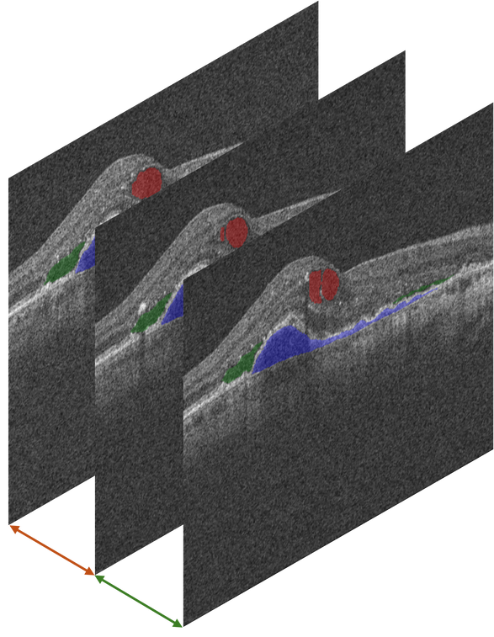
MATERIALS AND METHODS
MATERIALS AND METHODS
04
MATERIALS AND METHODS
04
04
04.C
FLUID VOLUME ESTIMATION
B-scan 1
IRF Volume from B-scan 2:
B-scan 2
IRF area
x
0.5
x
distance to the previous scan
B-scan 3
+
How the volume is calculated:
Calculate the area of fluid in a B-scan and multiply by half the distance to the neighbouring slices;
Sum the fluid volumes estimated from the B-scans that compose an OCT volume;
The OCT volume metadata is used in the estimation of the real volume represented in a voxel.
IRF area
x
0.5
x
distance to the next scan
IRF Volume from B-scan 1 and B-scan 3:
B-scan 1:
IRF area
x
0.5
x
distance to the next scan
B-scan 3:
IRF area
x
0.5
x
distance to the previous scan
Total IRF Volume in the OCT scan:
IRF Volume from B-scan 1
+
IRF Volume from B-scan 2
+
IRF Volume from B-scan 3
16|33

Slide 17
 |  | 0 | 1 | 2 | 3 | 4
 | Cirrus | 9 | 4 | 8 | 9 | 8
 | Spectralis | 9 | 5 | 8 | 9 | 8
 | T-1000 | 3 | 3 | 3 | 2 | 3
 | T-2000 | 4 | 1 + 1 | 5 | 5 | 5
 |  | 0 | 1 | 2 | 3 | 4
 | Cirrus | 5 | 4 | 5 | 5 | 5
 | Spectralis | 5 | 5 | 5 | 5 | 4
 | Topcon | 5 | 4 + 1 | 3 + 1 | 4 | 5
05
EXPERIMENTS
05.A
DATA PARTITION
Cross-validation | 5-fold validation, applied to entire OCT volumes
In Segmentation:
Only the volumes with fluid masks were used (70 OCT volumes);
Different split was used for each target fluid, in binary segmentation;
Fold 1 was randomly selected as the reserved fold.
In Generation:
All volumes were used;
One of the folds in this partition is the reserved fold from the segmentation experiments.
Volumes marked with a consist of 128 B-scans
Volumes marked with b consist of 64 B-scans
Folds
Volumes marked with a consist of 128 B-scans
Volumes marked with b consist of 64 B-scans
Folds
Vendors
Devices
a
a
b
a
b
a
a
a
a
b
a
a
a
17|33

Slide 18
05
EXPERIMENTS
05.B
EXPERIMENTS DESCRIPTION
EXPERIMENTS | DESCRIPTION
Experiment 1 | Fluid Segmentation with a Multi-class U-Net | 1.1 – Training with patches of size 256 x 128 pixels randomly extracted from the ROI (A). 1.2 – Training with large patches of size 496 x 512 pixels (B). 1.3 – Training with a varying number of vertical patches (four, seven, or thirteen) of size 496 x 128 pixels, extracted from B-scans resized to 496 x 512 pixels (C).
Experiment 2 | Fluid Segmentation with three Binary U-Nets | 2.1 – Training with the same loss as in Experiment 1, using two different data partitions. Two merging strategies were tested: probability-based and priority-based. 2.2 – Training with the balanced cross-entropy loss.
Experiment 3 | Synthesis of Intermediate Slices using a GAN | GAN trained to generate a fake B-scan between a pair of two known B-scans.
Experiment 4 | Synthesis of Intermediate Slices with a generative U-Net | Generative U-Net trained to synthesize a fake B-scan between a pair of two known B-scans.
Experiment 5 | Fluid Volume Estimation in Real OCT Volumes | Estimation of the fluid volumes from the GT and the fluid masks predicted by the segmentation model.
Experiment 6 | Fluid Volume Estimation in Super-resolved OCT Volumes | Estimation of the fluid volumes for generated and super-resolved OCT volumes, obtained through the GAN and using the masks predicted by the segmentation model.
18|33

Slide 19
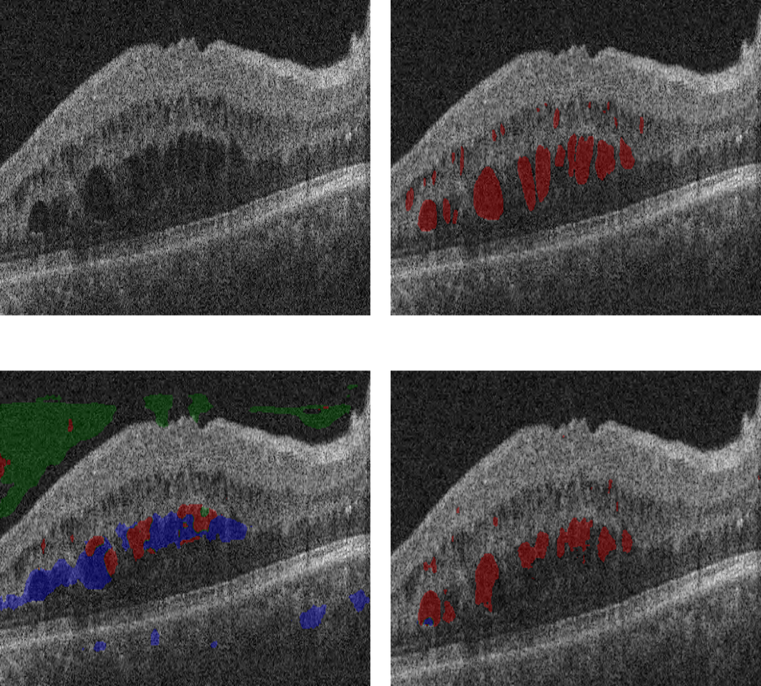
RESULTS AND DISCUSSION
MATERIALS AND METHODS
06
RESULTS AND DISCUSSION
04
06
06.A
FLUID SEGMENTATION WITH A MULTI-CLASS U-NET
B-scan
GT
Experiment 1.1 - Small Patch Extraction (A):
Poor segmentation results;
The patches were not big enough to capture the transitions between the retina and the background;
The model did not understand the relationships between the retinal anatomy and fluids.
Experiment 1.1 Prediction
Experiment 1.2 Prediction
Experiment 1.2 - Large Patch Extraction (B):
Better performance than in Experiment 1.1;
The segmentations of smaller fluid regions were not very accurate;
During patch extraction, the retina would often be split into two patches, resulting in a poor understanding of the transitions between the retina and the choroid.
IRF in red, SRF in green, and PED in blue
19|33

Slide 20
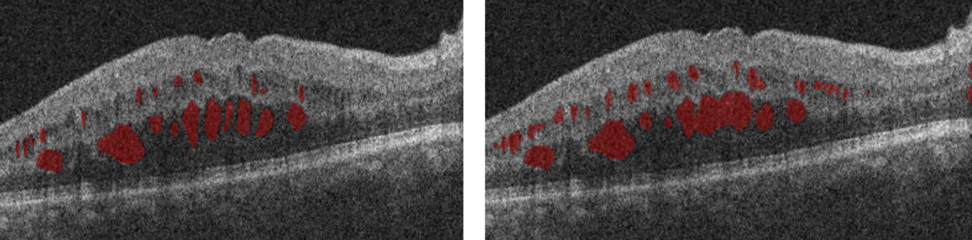
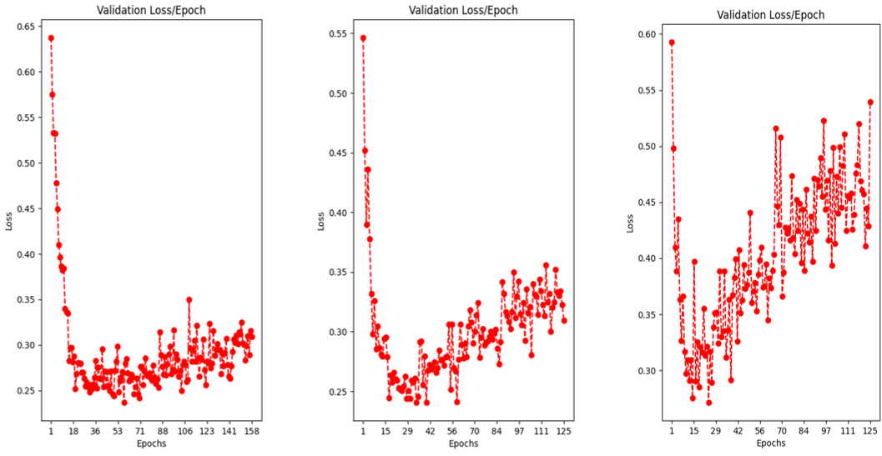
RESULTS AND DISCUSSION
RESULTS AND DISCUSSION
MATERIALS AND METHODS
06
RESULTS AND DISCUSSION
06
04
06
06.A
FLUID SEGMENTATION WITH A MULTI-CLASS U-NET
GT
Experiment 1.3 Prediction
Experiment 1.3 - Vertical Patch Extraction (C):
Most extensive experiment;
Better performances than in the previous experiments;
The vertical patches understood the anatomy of the retina;
The patches were small enough for the detailed segmentation of smaller fluid regions.
IRF in red
The impact of using four, seven, or thirteen patches per B-scan:
As the number of patches per B-scan increased, the convergence was faster, but the training was slower;
The models trained with four and seven patches per B-scan performed better than when trained with thirteen.
20|33
Four
Seven
Thirteen

Slide 21
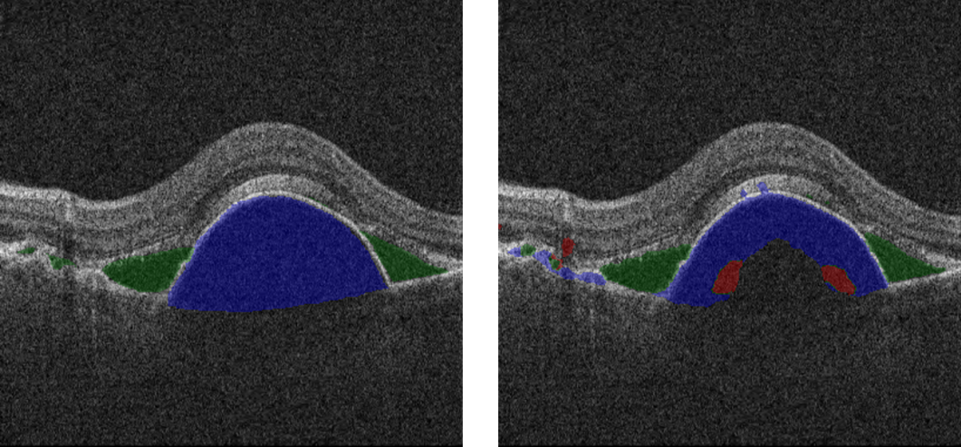
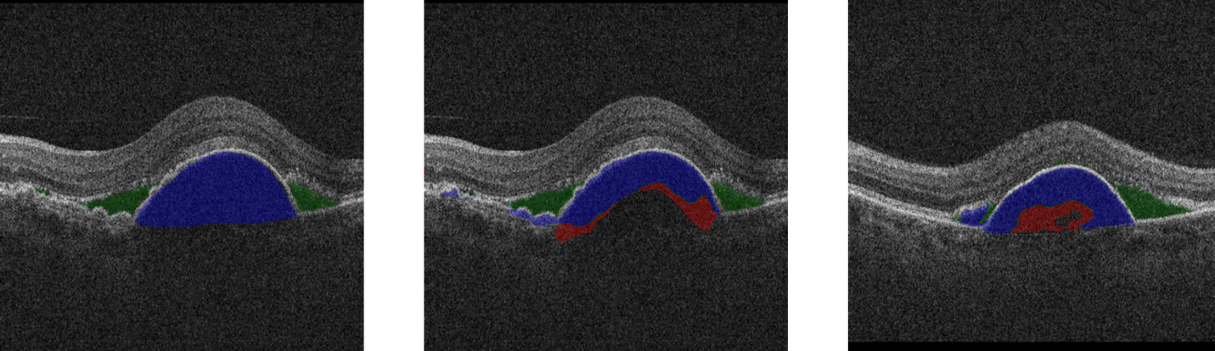
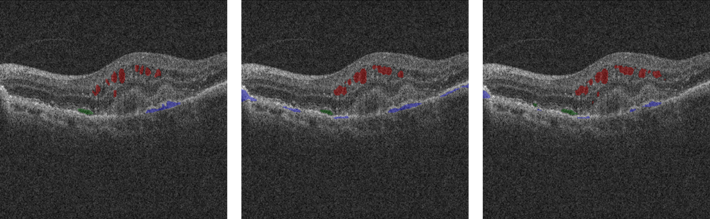
RESULTS AND DISCUSSION
RESULTS AND DISCUSSION
MATERIALS AND METHODS
06
RESULTS AND DISCUSSION
06
04
06
06.A
FLUID SEGMENTATION WITH A MULTI-CLASS U-NET
GT
No Rotation
10 Degree Rotation
The impact of rotation in the training data:
Transforming the inputs through random rotations significantly impacted the model’s performance;
When the model was trained without random rotations, the performance declined significantly;
The performance obtained when using a 5 degree random rotation was slightly worse than when using a 10 degree random rotation, but less prone to oversegmentation and more anatomically coherent.
IRF in red, SRF in green, and PED in blue
GT
5 Degree Rotation
10 Degree Rotation
IRF in red, SRF in green, and PED in blue
21|33

Slide 22
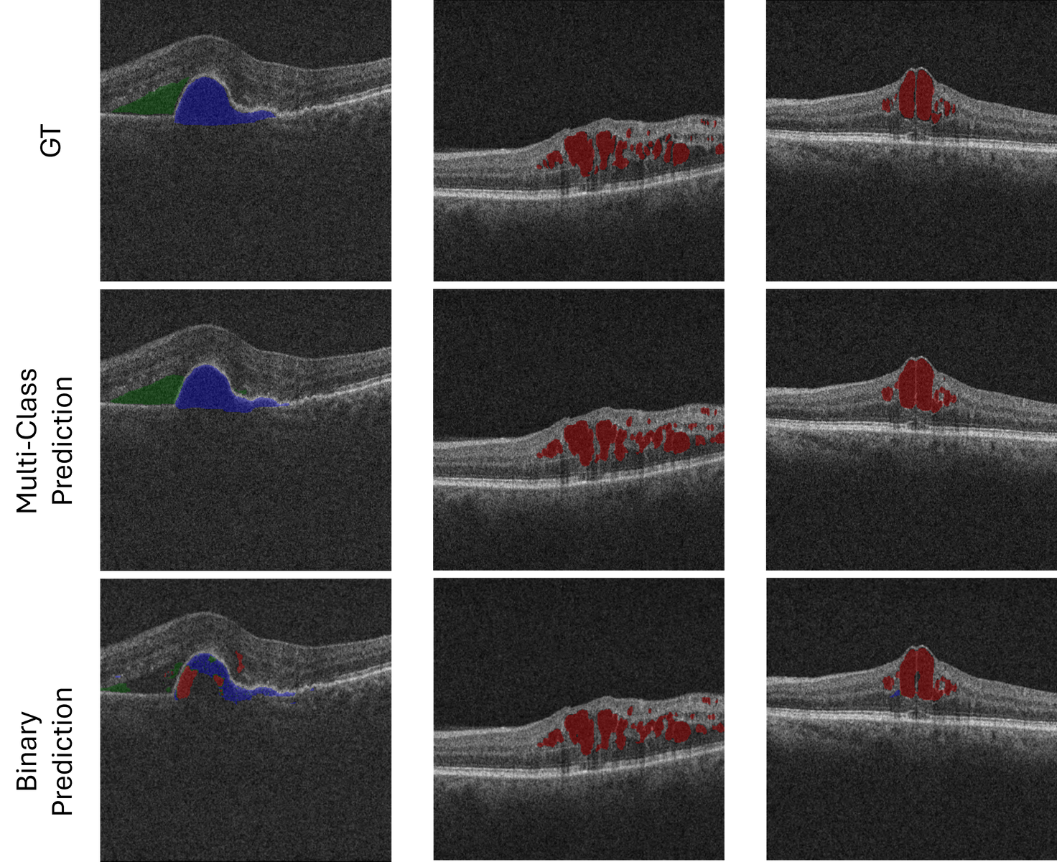
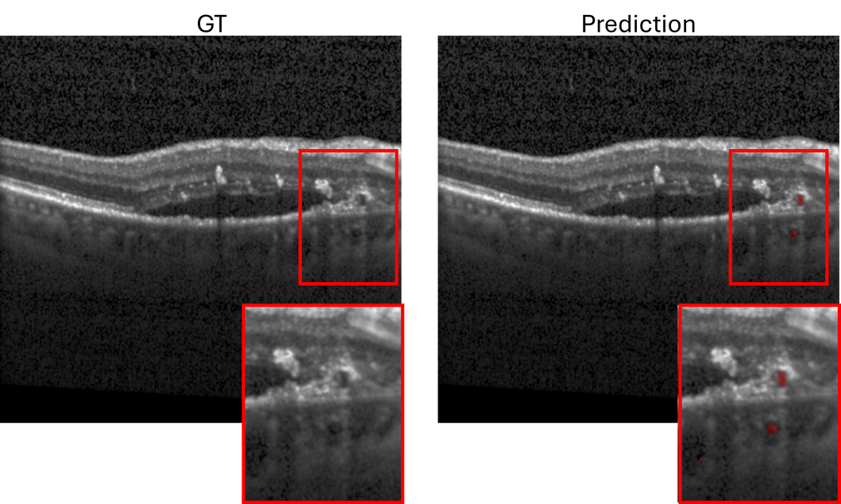
RESULTS AND DISCUSSION
RESULTS AND DISCUSSION
MATERIALS AND METHODS
06
RESULTS AND DISCUSSION
06
04
06
06.B
FLUID SEGMENTATION WITH THREE BINARY U-NETS
GT
Multi-class model
Binary models
Experiment 2.1 - Multi-class Loss:
Worse performance than the achieved by the multi-class model;
The models were prone to oversegment, due to the lack of inter-class competition;
Less aware of the anatomical relationships, a key capability developed in the multi-class model for the correct pixel classification.
IRF in red, SRF in green, and PED in blue
GT
Binary models
Experiment 2.2 - Balanced Cross-Entropy Loss:
Significantly worse performance;
The models segmented, in almost all slices, small regions of fluid;
These small segmentations are not heavily penalized through the loss function.
IRF in red
22|33

Slide 23
RESULTS AND DISCUSSION
RESULTS AND DISCUSSION
MATERIALS AND METHODS
06
RESULTS AND DISCUSSION
06
04
06
06.C
FLUID SEGMENTATION - COMPARISON IN RETOUCH
Comparison with the literature:
The mean Dice coefficients, computed across the four validation folds of the best performing segmentation models, were compared to the work of Alsaih et al. [10];
In this work, the authors implemented three networks (trained with different optimizers) to segment the retinal fluid in the RETOUCH dataset.
Dice Coefficients
Runs | IRF | SRF | PED
Multi-class | 0.67 | 0.80 | 0.72
Binary | 0.60 | 0.75 | 0.44
U-Net trained with entire image [10] | 0.29 | 0.47 | 0.18
U-Net trained with 128 x 128 patches [10] | 0.68 | 0.61 | 0.84
Training the network on patches significantly improves the fluid segmentation;
Performs equally in IRF, but the larger patches promote a better SRF segmentation while harming the PED delimitation;
Our implementation achieved comparable results with lower computational cost.
[10] K. Alsaih et al., “Deep learning architectures analysis for age-related macular degeneration segmentation on optical coherence tomography scans” Computer Methods and Programs in Biomedicine, vol. 195, p. 105 566, 2020, ISSN: 0169-2607. DOI: 10.1016/j.cmpb.2020.105566.
23|33

Slide 24
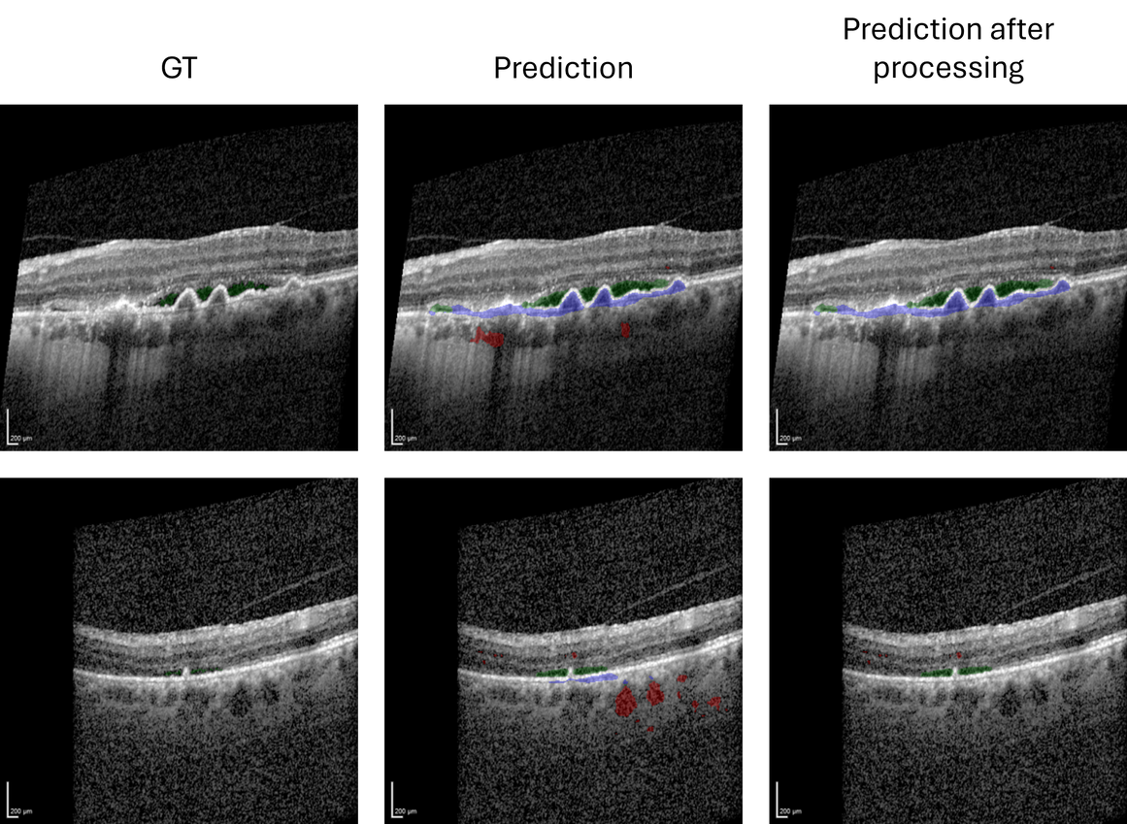

RESULTS AND DISCUSSION
RESULTS AND DISCUSSION
MATERIALS AND METHODS
06
RESULTS AND DISCUSSION
06
04
06
06.D
FLUID SEGMENTATION - PERFORMANCE IN CHUSJ
Results in CHUSJ Dataset:
Satisfying segmentation of the retinal fluids;
Consistently predicted fluid in choroid region;
Similarly, the PED was constantly oversegmented, influenced by the segmentation criteria seen in the training data.
Caused by the differences between datasets
Processing with retinal delimitation:
The overall Dice coefficient was significantly improved;
The anatomical coherence of the segmentations was also enhanced.
Dice Coefficients
 | IRF | SRF | PED
Without Retinal Delimitation | 0.17 | 0.44 | 0.14
With Retinal Delimitation | 0.52 | 0.68 | 0.39
IRF in red, SRF in green, and PED in blue
24|33

Slide 25

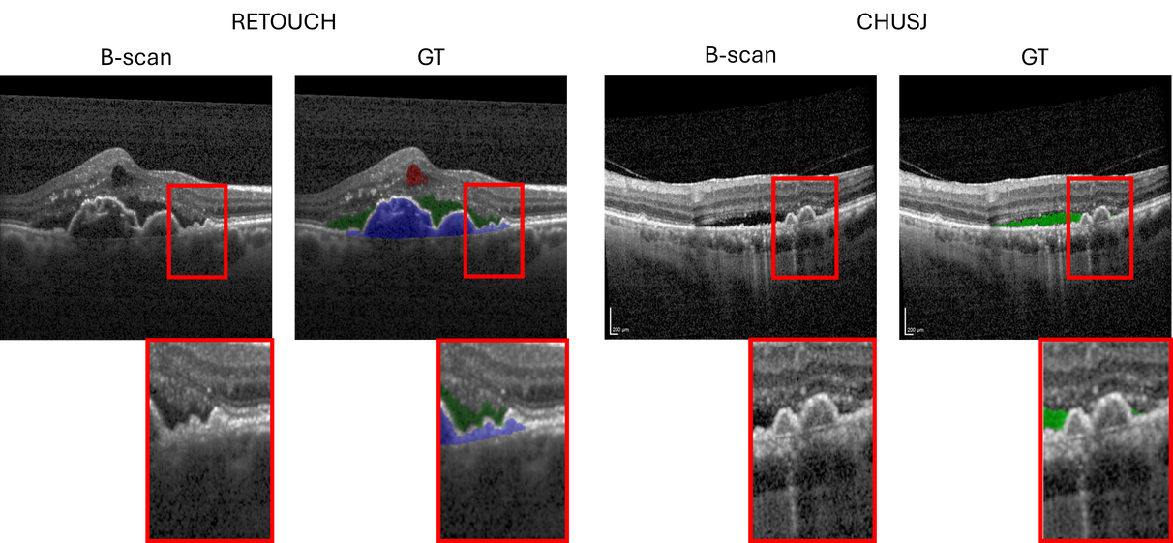
RESULTS AND DISCUSSION
RESULTS AND DISCUSSION
MATERIALS AND METHODS
06
RESULTS AND DISCUSSION
06
04
06
06.D
FLUID SEGMENTATION - PERFORMANCE IN CHUSJ
CHUSJ Dataset Characteristics which Influence the Segmentation Performance:
The choroid definition and noise levels, which are significantly different from the training data;
Only one clinician segmented the retinal fluids, while training data was annotated by two clinicians;
The segmentation criteria of PED differs from the criteria in the training data.
IRF in red, SRF in green, and PED in blue
25|33

Slide 26
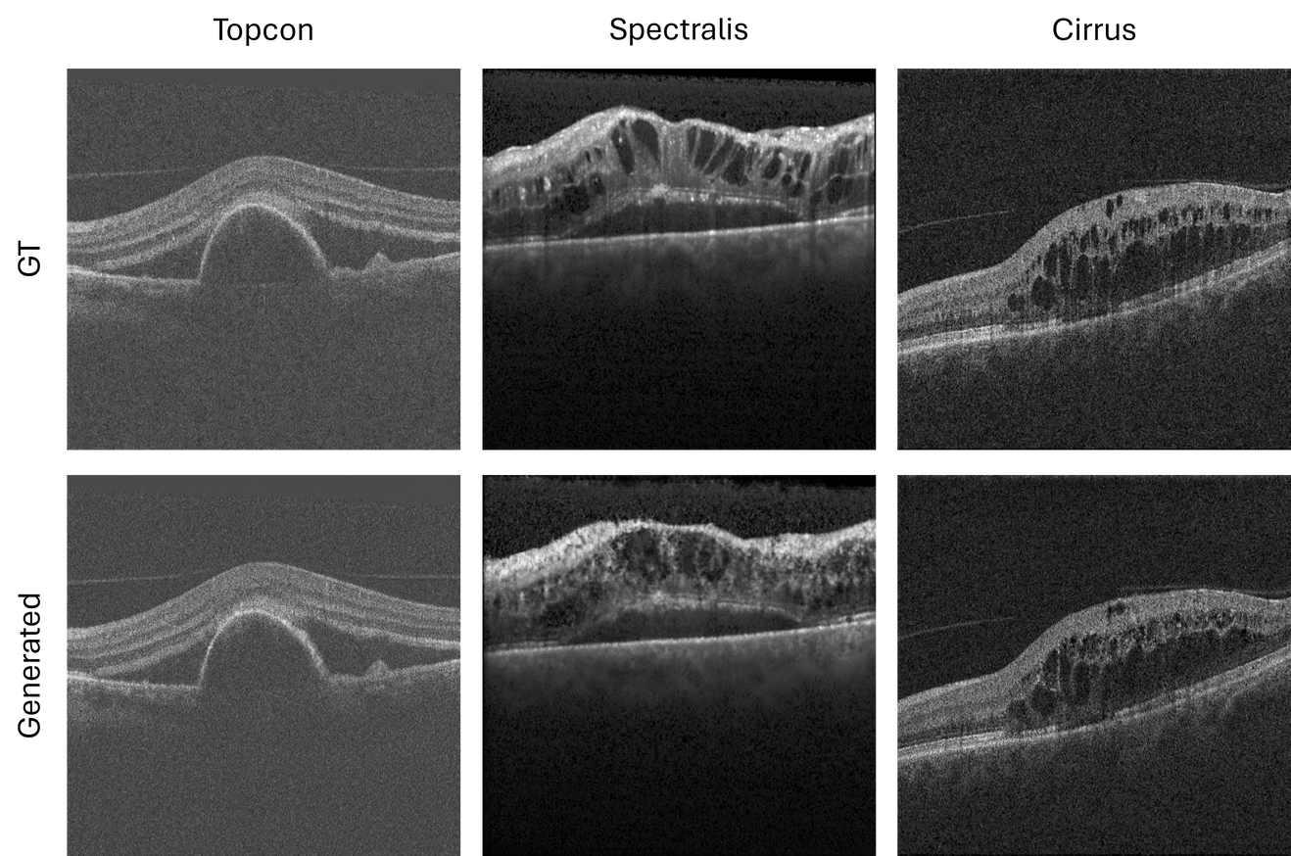
RESULTS AND DISCUSSION
RESULTS AND DISCUSSION
MATERIALS AND METHODS
06
RESULTS AND DISCUSSION
06
04
06
06.E
INTERMEDIATE SLICE GENERATION - GAN
Realistic B-scans were generated;
The distance between slices significantly influenced the generation of intermediate slices;
Larger fluids are easier to generate;
The generation of IRF is the most difficult task;
In OCT, losses based on pixel-wise comparisons need to be complemented with strong perceptual losses.
26|33

Slide 27
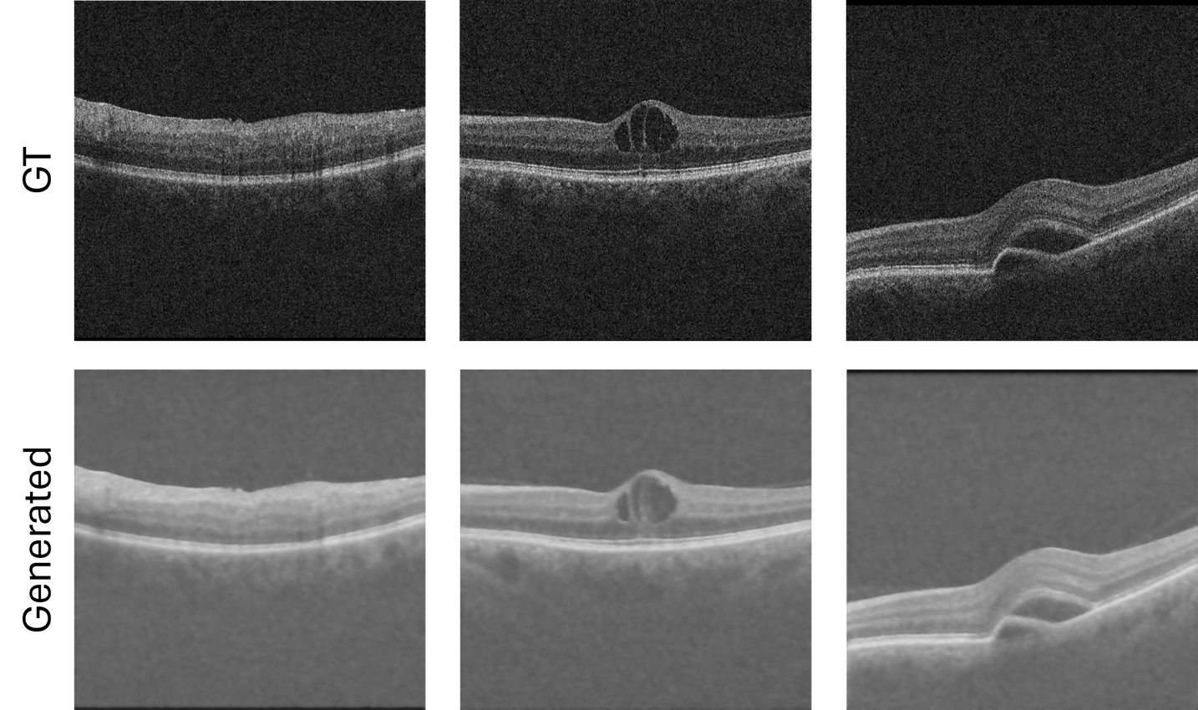
RESULTS AND DISCUSSION
RESULTS AND DISCUSSION
MATERIALS AND METHODS
06
RESULTS AND DISCUSSION
06
04
06
06.F
INTERMEDIATE SLICE GENERATION - U-NET
Produced smoothed intermediate images, with poor details and definition;
By training the network using only a pixel-wise loss (MAE), the model produces blurred outputs;
The introduction of perceptual components to the network loss would lead to a more accurate representation of the B-scans.
27|33

Slide 28
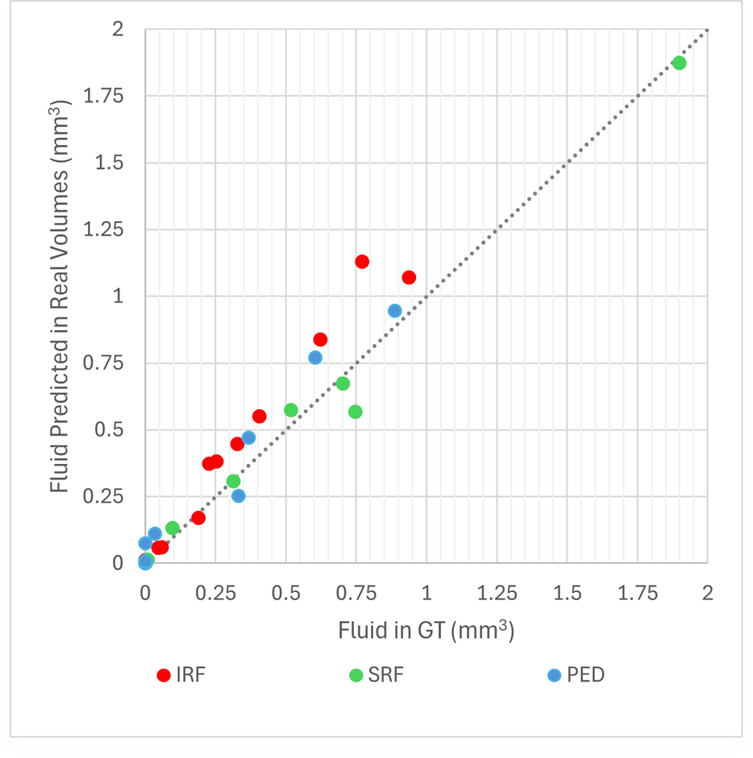
RESULTS AND DISCUSSION
RESULTS AND DISCUSSION
MATERIALS AND METHODS
06
RESULTS AND DISCUSSION
06
04
06
06.G
FLUID VOLUME ESTIMATION IN ORIGINAL OCT VOLUMES
Similar to the values estimated using the GT masks;
The volume differences are limited by the capabilities of the segmentation model;
Most errors occur in IRF, where the model performed worse and the fluid regions are smaller.
Fluid Volume MAE in mm3 between GT and predicted masks
 | IRF | SRF | PED
MAE | 0.092 | 0.025 | 0.041
28|33

Slide 29
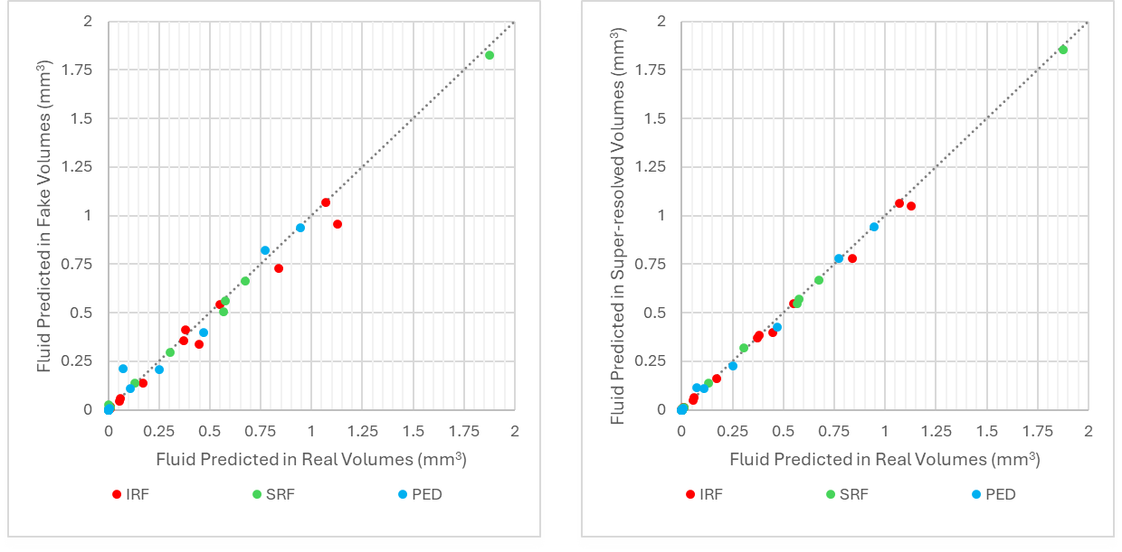
RESULTS AND DISCUSSION
RESULTS AND DISCUSSION
MATERIALS AND METHODS
06
RESULTS AND DISCUSSION
06
04
06
06.H
FLUID VOLUME ESTIMATION IN SUPER-RESOLVED OCT VOLUMES
The results in the super-resolved volumes are really similar to those predicted through the fluid segmentation of the original OCT volumes;
Most differences occur in the segmentation of generated IRF, which was the fluid generated with poorer quality;
The Spectralis volumes were those where most differences appear, since the quality of the generated fluid is poorer, due to the larger inter-slice distance.
29|33

Slide 30
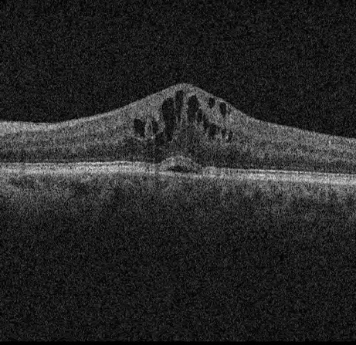
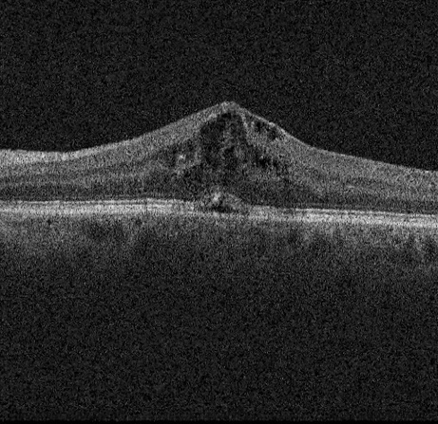
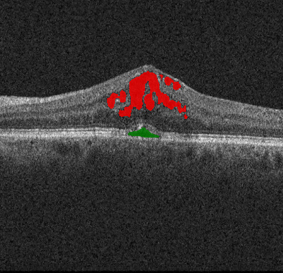
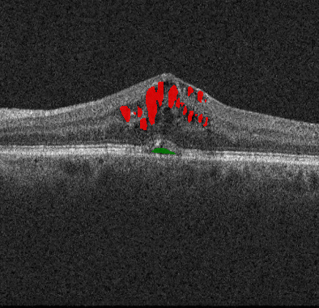
RESULTS AND DISCUSSION
RESULTS AND DISCUSSION
MATERIALS AND METHODS
06
RESULTS AND DISCUSSION
06
04
06
06.H
FLUID VOLUME ESTIMATION IN SUPER-RESOLVED OCT VOLUMES
Fluid Volume MAE in mm3 between predicted masks in the original OCT volumes and in the generated OCT volumes
 | IRF | SRF | PED
MAE | 0.037 | 0.012 | 0.023
Fluid Volume MAE in mm3 between predicted masks in the original OCT volumes and in the super-resolved OCT volumes
 | IRF | SRF | PED
MAE | 0.016 | 0.005 | 0.009
30|33
IRF in red and SRF in green

Slide 31
07
CONCLUSIONS
SEGMENTATION
GENERATION
FLUID VOLUME ESTIMATION
The size of the input patchs and how they are extracted stroungly impact the performance of the segmentation model;
The random transformations applied to the input change the model’s performance;
Results comparable with the literature were obtained, despite using a computationally cheaper approach.
Inter-slice distance is very relevant in intermediate slice generation;
Pixel-wise losses motivate the generative models to produce accurate representations of speckle noise, disregarding the appearance of some anatomically important structures;
Small fluid regions are harder to generate, as they change faster between consecutive B-scans.
Inherently dependent on the segmentation and generation quality;
More influenced by the segmentation model than the generative model;
Less accurate in IRF, which is hard to segment and generate due to its anatomical characteristics.
31|33

Slide 32
LIMITATIONS AND FUTURE WORK
08
LIMITATIONS AND FUTURE WORK
08
LIMITATIONS
FUTURE WORK
SEGMENTATION
Baseline U-Net is not capable of both detailed and broader segmentation;
Generalizes poorly in other data sources.
SEGMENTATION
Implementation of more complex networks, which combine shallow and deep features;
Condition the input of the segmentation network to include additional information of the retina;
Train the model on data from different sources.
GENERATION
Focuses more on the accurate representation of speckle rather than the generation of fluids and other anatomically relevant structures.
GENERATION
Include stronger perceptual losses (e.g. LPIPS);
Introduce attention blocks into the generator architecture.
32|33

Slide 33
THANK YOU!
ANY QUESTION?

